Slide 1

HIGHER EDUCATION FOR WOMEN
AVINASHILINGAM INSTITUTE FOR HOME SCIENCE AND
SCHOOL OF ENGINEERING
DEPARTMENT OF COMPUTER SCIENCE AND ENGINEERING
SMART PARKING WITH NUMBER PLATE RECOGNITION
Under the Guidance of:
Mrs. R. PadmaPriya (AP/CSE)
Presented by:
ASHMITHA.M-23UEO006 LAKSHITHA.A-23UEO028 SAMVITHA.T-23UEO042 THENMOZHI.M-23UEO059 VARSHINI.S-23UEO060

Slide 2
AGENDA
Abstract
Introduction
Problem statement
Objective
Literature survey
Existing System
Proposed System
Block Diagram
Output
Result analysis
Inference
Learning outcomes
Future scope
Conclusion
References
2

Slide 3
ABSTRACT
The project presents a Smart Parking System using Number Plate Recognition (NPR) to automate and optimize the parking process.
The system uses a camera or image input to capture the vehicle’s number plate.
The captured image is processed using EasyOCR, an Optical Character Recognition tool, to accurately extract the vehicle number.

Slide 4
All parking details, including vehicle number, slot number, entry time, and exit time, are stored in a database for efficient management.
A web-based dashboard displays real-time parking status, showing available slots and occupied slots.
The system also updates the exit time when the vehicle leaves and frees the parking slot for future use.

Slide 5
INTRODUCTION
A Smart Parking System is a web-based application that helps users and administrators monitor and manage parking spaces efficitenly.
The system uses a dashboard to display real-time parking data such as available slots,occupied slots, and vechicle entry/exit details.
It improves parking efficiency and reduces manual work

Slide 6
PROBLEM STATEMENT
In urban areas, finding available parking spaces is difficult and time-consuming. Traditional parking systems do not provide real-time information about slot availability and do not maintain proper records of vehicle entry and exit. This leads to traffic congestion, fuel wastage, and inefficient parking management.

Slide 7
OBJECTIVE
To develop a smart parking system for efficient space management, track vehicle entry and exit time automatically, display available and occupied parking slots, maintain parking records in a database to reduce time and fuel consumption for users

Slide 8
LITERATURE SURVEY
S.No | Paper Title | Author | Journal | Methodology | Inference
1. | Evaluating the Impact of Smart Parking Systems on Parking Violations | Atusa Javaheri,Sai Sneha | Published in IEEE Access(2024) | Collected parking data (2018–2023), applied an LSTM model for prediction, compared results with actual data, and validated using KS test with key factor analysis. | Limitations: Accuracy decreases due to image quality, skew/blur, varying formats, and environmental conditions.
2. | A Smart Real-Time Parking Control and Monitoring System. | Abdelrahman Osman Elfaki, Wassim Messoudi | Sensors is an international peer-reviewed journal by MDPI (2023). | Uses IoT (ESP32-CAM, sensors), AI/ML, and OCR-based ANPR with Firebase cloud and mobile app for smart parking detection. | Limitations: Despite low OCR accuracy (~58%) and less reliable motion sensors, the system offers a low-cost and efficient smart parking solution.

Slide 9
S.No | Paper Title | Author | Journal | Methodology | Inference
3. | Number Plate Recognition Smart Parking Management System using IoT | Allah Ditta Muhammad Maroof Ahmed Tehseen Mazhar | Published in MeasurementSensors (Elsevier), Volume 37, 2025, DOI: 10.1016/j.measen.2024.101409. | Uses ANPR with OCR, IoT sensors (ESP32, IR), OpenCV & Google Vision AI for detection, stores data via PHP-MySQL, and enables time tracking, billing, and display of parking details. | Limitations: Sensitive to lighting/camera quality, costly to install, needs stable internet, raises privacy concerns, requires maintenance, and struggles with unclear plates.
4. | Advanced IoT-Integrated Parking Systems with Automated License Plate Recognition and Payment Management. | Gulmini Pradhan Manas Ranjan Prusty | Scientific Reports (Springer Nature, 2025) | Uses IoT-based smart parking with IR sensors, cameras, YOLO and OCR (Tesseract) on Raspberry Pi/ESP32 for vehicle detection, tracking, slot allocation, and automated billing in real time. | Limitations: Performance is affected by lighting, image quality, camera positioning, and OCR errors on unclear or complex plates.

Slide 10
S.No | Paper Title | Author | Journal | Methodology | Inference
5. | Automatic Number Plate Recognition System Using Optical Character Recognition | Monika Arora, Anubha Jain | Published in International Journal of Scientific Research in Computer Science, Engineering and Information Technology (IJSRCSEIT), 2019. | Uses ANPR with OCR, edge detection and Hough transform, along with ANN and kNN for classification, implemented on Android with database support. | Limitations: Accuracy depends on image quality and camera position, and decreases for blurred, skewed, or complex plate conditions.

Slide 11
EXISTING SYSTEM
Vehicles are recorded manually by a security guard using a register or token system. This process is slow and depends completely on human effort.
All details like vehicle number and entry time are stored in paper registers or basic systems, which are difficult to maintain and prone to data loss.
There is no automatic system to assign parking slots. Drivers have to search for available space manually, leading to confusion and inefficiency.

Slide 12
Both entry and exit take more time due to manual verification, causing long queues and delays, especially during peak hours.
Human errors such as incorrect vehicle numbers, missing records, and wrong time entries are common, reducing reliability.
There is no system to display available or occupied slots. Users and administrators cannot track parking status or vehicle movement in real time.

Slide 13
PROPOSED SYSTEM
A camera captures the vehicle’s number plate image when it
enters the parking area, eliminating manual data entry.
Using OCR (like EasyOCR), the system automatically extracts the vehicle number from the image accurately and quickly.
The system automatically assigns the next available parking slot, ensuring efficient space utilization and avoiding confusion.

Slide 14


A dashboard displays parking slots as:
Available Occupied
This helps users and administrators monitor parking status instantly.
Entry and exit times are recorded automatically in the database, enabling accurate tracking of vehicle movement.
The system minimizes human involvement, reduces errors, speeds up the process, and provides a smooth and automated parking experience.
10

Slide 15
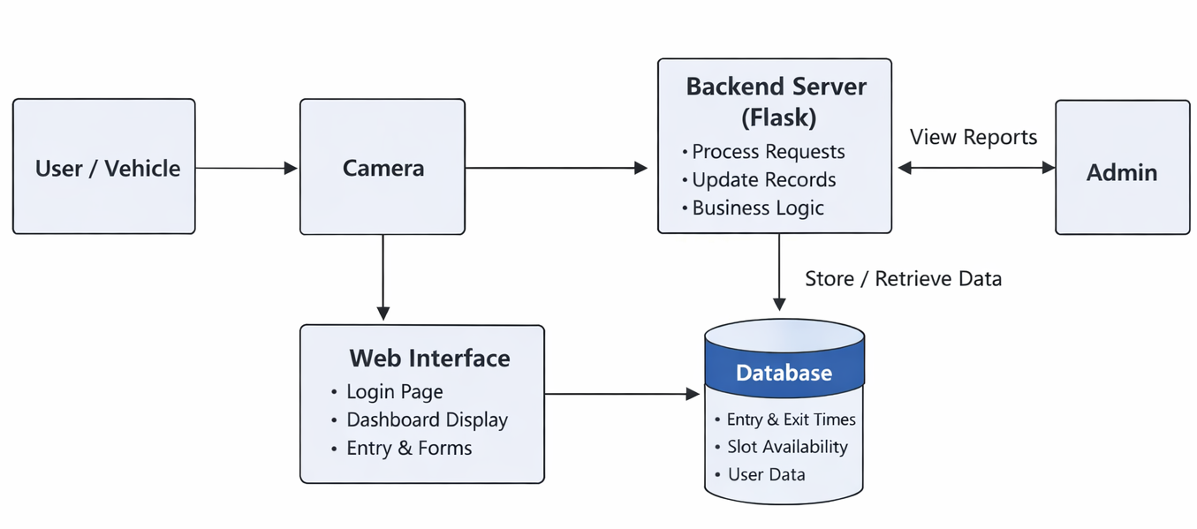
BLOCK DIAGRAM

Slide 16
EXPLANATION
Vehicle entry/exit is detected using sensors or cameras, identifying movement and initiating the parking process
Cameras capture vehicle data, check slot availability, and send information to the system
Backend server processes the data, manages parking logic, and updates real-time status
Database stores all details such as entry/exit time, vehicle information, and slot allocation
Web interface and admin panel display parking status, allow user interaction, and enable system monitoring
12

Slide 17
SYSTEM MODULES
MODULE 1: User Interface Module
MODULE 2: User Authentication Module
MODULE 3: Vehicle Registration and Detection
Module
MODULE 4: Parking Slot Management Module
MODULE 5: Database Management Module
14

Slide 18
1.User Interface Module
Files involved: home.html, home.css, result.html, result.css
Explanation:
Display home page. Shows messages. Handles user interaction.
18

Slide 19
2.User Authentication Module
Files involved: login.html, login.css
Explanation:
The module handles user login functionality. It ensures only authorized users can access the parking system. Takes username & password input. Validates credentials using backend. Redirects to dashboard after successful login.

Slide 20
3.Vehicle Registration & Detection Module
Files involved: register.html, ocr.py, script.js
Explanation:
This is the core module of our project. Captures vehicle image. Uses OCR (ocr.py) to extract number plate. Registers vehicle into system. Sends data to backend for slot allocation.
20

Slide 21
4.Parking Slot Management Module
Files involved: dashboard.html, dashboard.css, app.py
Explanation:
The module manages parking slots visually, it shows Available Slots(green )&Occupied Slots(red ),updates automatically when a vehicle is registered. Prevents overbooking(max 35 slots).
21

Slide 22
5. Database Management Module
Files involved: database.py, parking.db
Explanation:
Handles all data storage and retrieval. It stores vehicle number plates and slot allocation details. Performs CRUD operations(Create , Read , Update , Delete) and ensures no duplicate or overflow entries.

Slide 23
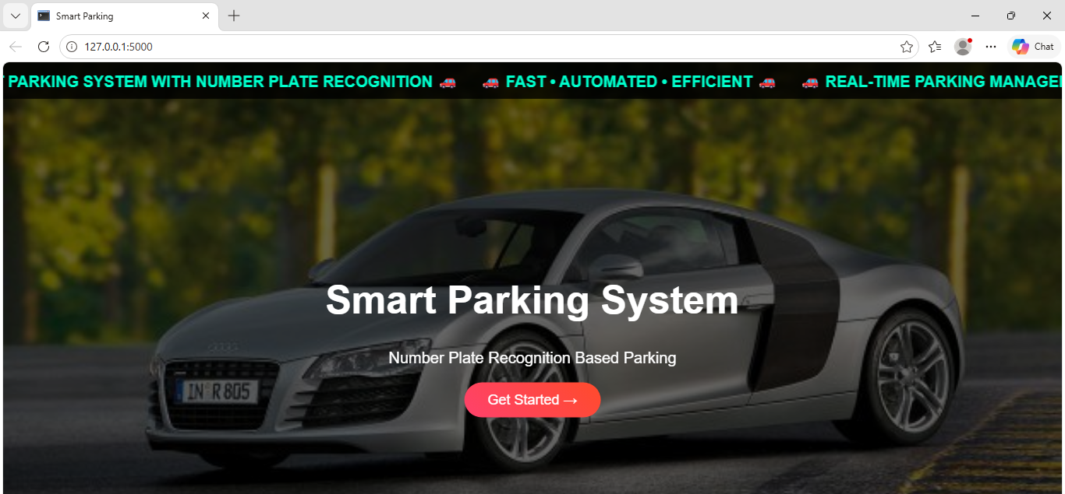
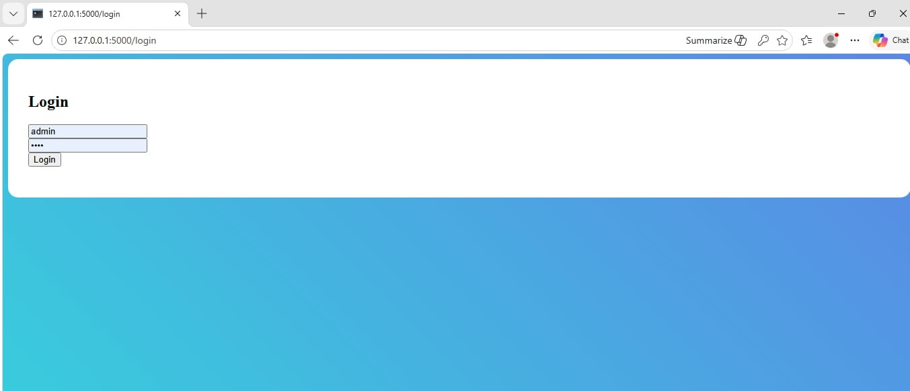
OUTPUT
21

Slide 24
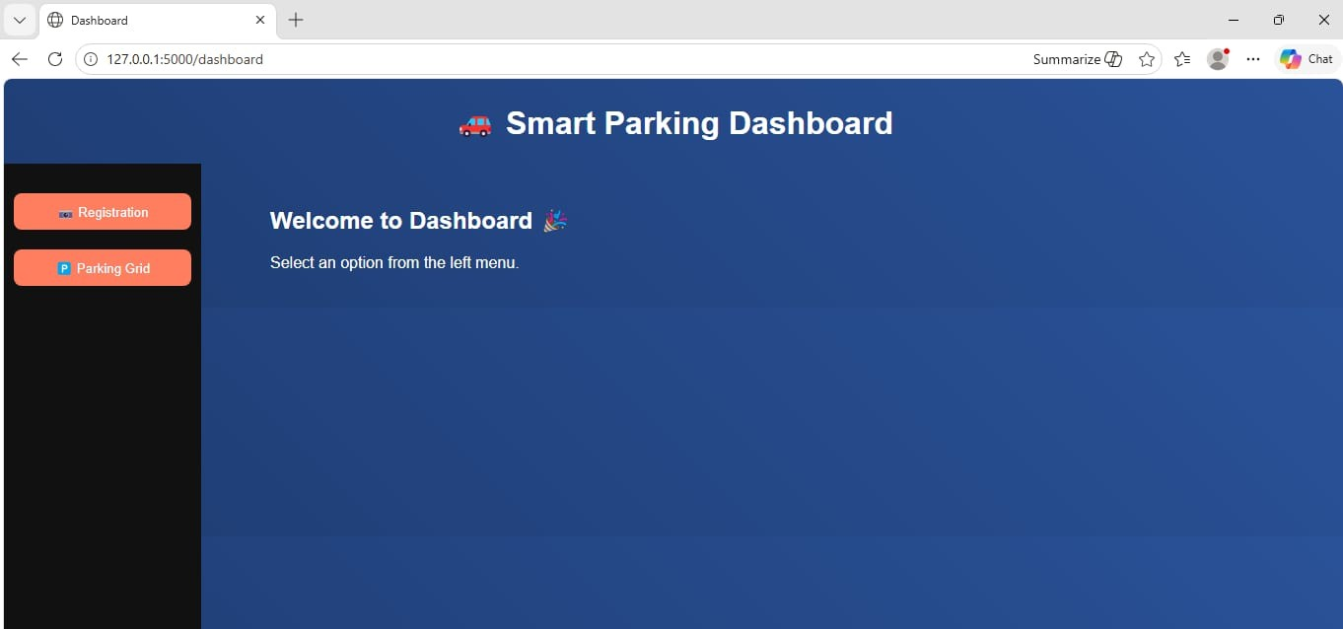
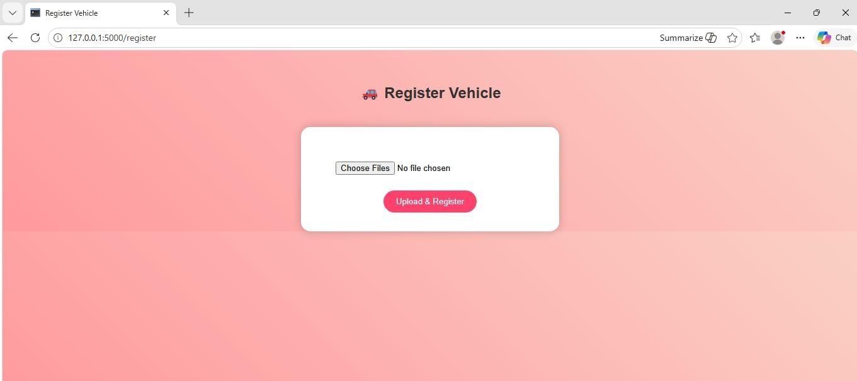

Slide 25
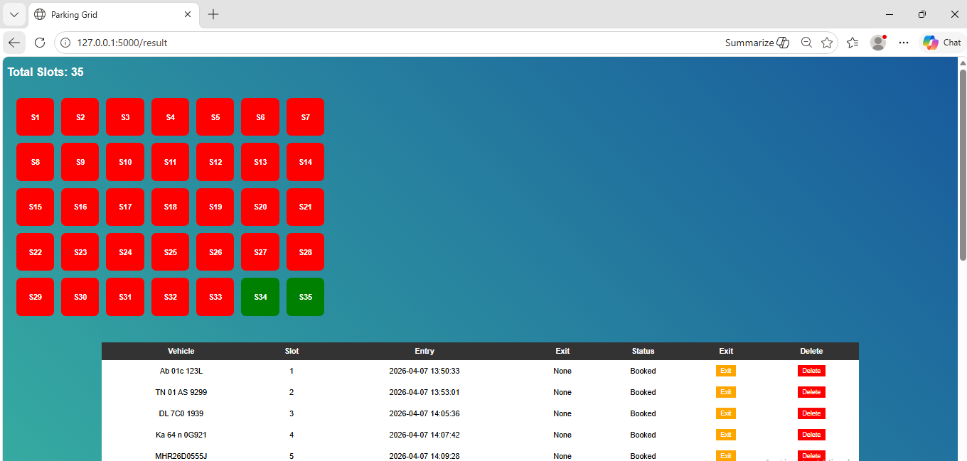

Slide 26
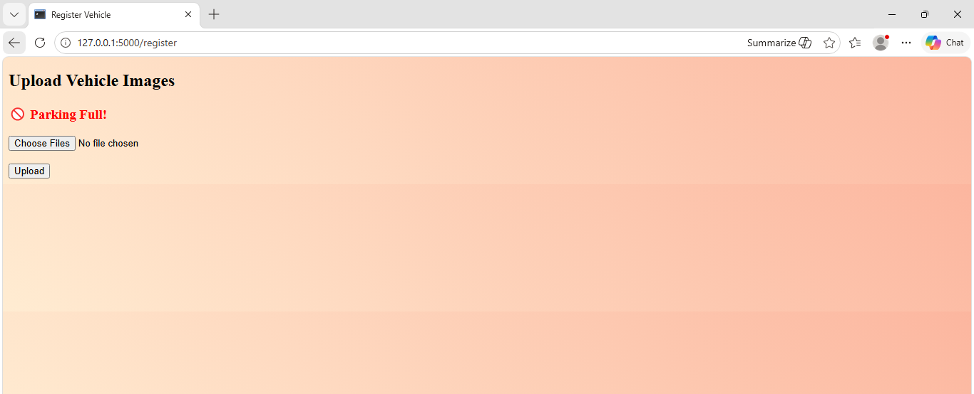

Slide 27
RESULT ANALYSIS
The system efficiently records vehicle entry and exit details.
Parking slots are automatically allocated based on availability.
The grid view clearly shows occupied and free slots.
Data is stored accurately in the database (SQLite).
The system reduces manual errors and workload.
Overall performance is fast and reliable for small-scale parking.

Slide 28
INFERENCES
Automation improves parking efficiency and management.
Web-based systems provide real-time monitoring.
Slot allocation ensures better space utilization.
Digital systems reduce human dependency.
The model is scalable for larger applications.
Can be enhanced with OCR, IoT, and AI technologies.

Slide 29
LEARNING OUTCOMES
Learned to build a Flask-based web application.
Gained knowledge of HTML and CSS frontend design.
Understood database integration using SQLite.
Implemented CRUD operations in real-world use case.
Improved problem-solving and debugging skills.
Learned integration of frontend, backend, and database.

Slide 30
FUTURE SCOPE
AI-based prediction: Predicts parking availability and reduces traffic congestion.
Smart city integration: Connects with traffic systems and centralized monitoring.
Enhanced security: Tracks vehicles and detects unauthorized entry.
Autonomous vehicles: Supports self-driving cars for automatic parking
Cloud storage: Stores and analyzes parking data efficiently.
Eco-friendly: Reduces fuel consumption and pollution.

Slide 31
CONCLUSION
The system provides an efficient solution for managing parking spaces through real-time monitoring and a user-friendly dashboard. It reduces manual effort, improves space utilization, and enhances overall parking management efficiency.

Slide 32
REFERENCES
1. https://ieeexplore.ieee.org/document/10758649/
2. https://www.mdpi.com/1424-8220/23/24/9741
3.https://www.sciencedirect.com/science/article/pii/S2665917424003854
4.https://www.nature.com/articles/s41598-025-86441-w
5.https://www.academia.edu/download/71154866/cseit1952280.pdf

Slide 33
THANK YOU

